Slide 1
Economic Impact Analysis of FY2022 North Dakota Charitable Gaming
March
2024
Cullen F. Goenner, PhD
Consultant
Charitable Gaming Association of North Dakota

Slide 2






ND CHARITABLE GAMING Direct Effects (Fiscal year 2022)
ADJUSTED GROSS REVENUES
CHARITABLE CONTRIBUTIONS
JOBS
LABOR INCOME
GAMING TAXES
$222
Million
$74
Million
2,100
Workers
$71
Million
$19.9
Million

Slide 3
ND CHARITABLE GAMING ND Employment Comparison
Industry | Jobs
Machinery manufacturing | 6154
Food manufacturing | 5054
Oil and gas extraction | 2421
Fabricated metal product manufacturing | 2175
Wood product manufacturing | 2153
Charitable gaming | 2100
Mining (except oil and gas) | 1985
Plastics and rubber products manufacturing | 1568
Nonmetallic mineral product manufacturing | 1228
Computer and electronic product manufacturing | 1224
Source: Bureau of Economic Analysis (2021)

Slide 4




ND CHARITABLE GAMING Input-output model and the Economic Multiplier
The total economic impact an industry contributes to the economy is determined by using an input-output model, which links the direct effects from an industry’s operations to the changes in the state’s economy that are attributable to this activity.
DIRECT
INDIRECT
INDUCED
Impact of charitable gaming operations.
Suppliers of intermediate goods and services needed for gaming operations.
Household spending of employees tied to direct and indirect effects

Slide 5
ND CHARITABLE GAMING Total Economic Impact on North Dakota
TOTAL SALES
JOBS
LABOR INCOME
TAXES
$330
Million
3,065
Workers
$108
Million
$35
Million

Slide 6
ND CHARITABLE GAMING Industry Impact
$220 million total impact on Arts, Entertainment, and Recreation

Slide 7
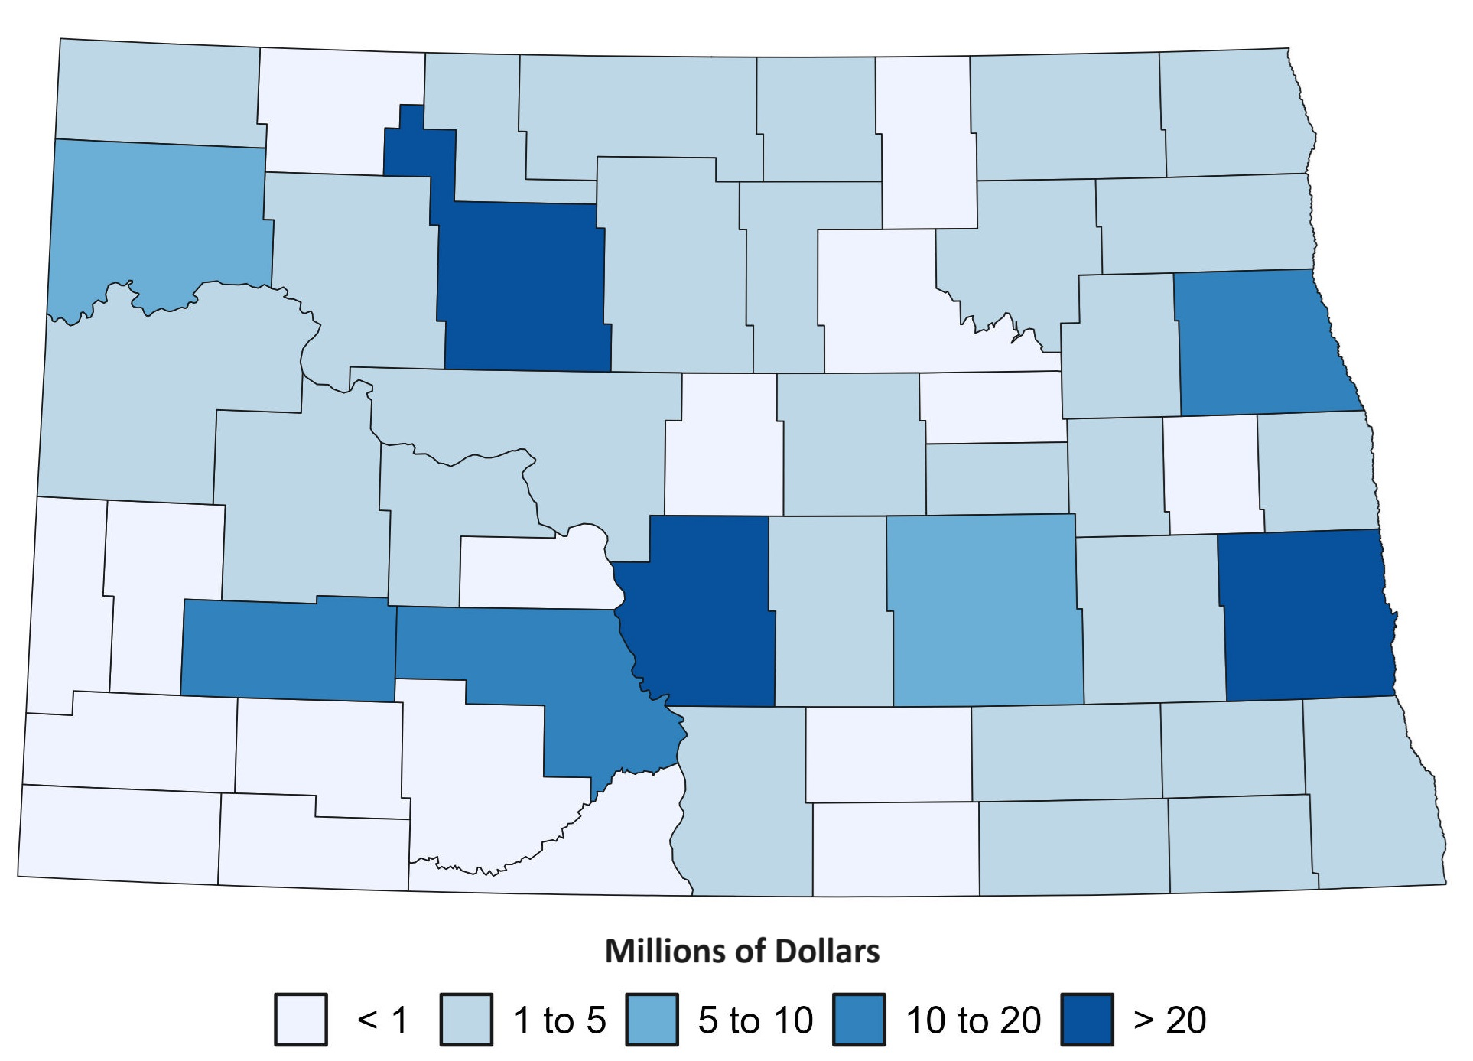
ND CHARITABLE GAMING Statewide Direct Impact on Sales Per Capita
County | Sales | Population (2020) | Sales Per Capita
Kidder | $ 1,430,849 | 2395 | $597
Renville | $ 1,327,682 | 2282 | $582
McHenry | $ 2,828,907 | 5332 | $531
Lamoure | $ 2,151,374 | 4091 | $526
Foster | $ 1,729,382 | 3396 | $509
Nelson | $ 1,489,742 | 3015 | $494
Cavalier | $ 1,823,122 | 3706 | $492
Mclean | $ 4,754,073 | 9770 | $487
Divide | $ 1,049,694 | 2202 | $477
Griggs | $ 1,086,482 | 2306 | $471
Cass | $ 41,453,672 | 184,528 | $225

Slide 8
ND CHARITABLE GAMING Impact on Tax Revenue
 | FY 2022
State and Local Taxes | $34,533,799
ND Gaming Taxes | $19,856,122
Personal Income | $916,877
Sales tax | $8,624,819
Property | $5,135,981
Federal Taxes | $19,264,617
Personal Income | $6,151,495
Indirect Business Tax | $1,306,673
Social Security (FICA) | $11,806,449
Total Taxes | $53,798,416

